Slide 1
Chapter 6:
Programming Languages
Computer Science: An Overview
Eleventh Edition
by
J. Glenn Brookshear

Slide 2
Chapter 6: Programming Languages
6.1 Historical Perspective
6.2 Traditional Programming Concepts
6.3 Procedural Units
6.4 Language Implementation
6.5 Object Oriented Programming
6.6 Programming Concurrent Activities
6.7 Declarative Programming
0-<number>

Slide 3
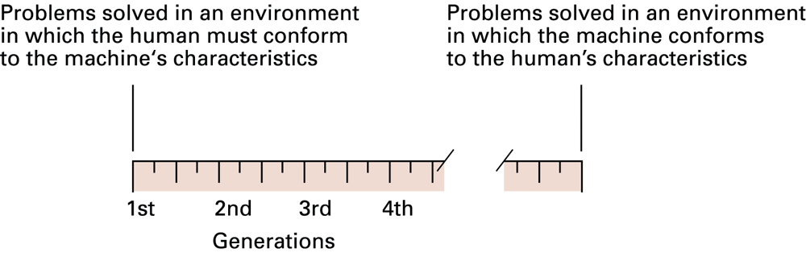
Figure 6.1 Generations of programming languages
0-<number>

Slide 4
Second-generation:
Assembly language
A mnemonic system for representing machine instructions
  Mnemonic names for op-codes
  Identifiers: Descriptive names for memory locations, chosen by the programmer
0-<number>

Slide 5
Assembly Language Characteristics
One-to-one correspondence between machine instructions and assembly instructions
  Programmer must think like the machine
Inherently machine-dependent
Converted to machine language by a program called an assembler
0-<number>

Slide 6
Program Example
Machine language
156C
166D
5056
30CE
C000
Assembly language
LD R5, Price
LD R6, ShipCharge
ADDI R0, R5 R6
ST R0, TotalCost
HLT
0-<number>

Slide 7
Third Generation Language
Uses high-level primitives
  Similar to our pseudocode in Chapter 5
Machine independent (mostly)
Examples: FORTRAN, COBOL
Each primitive corresponds to a sequence of machine language instructions
Converted to machine language by a program called a compiler
0-<number>

Slide 8
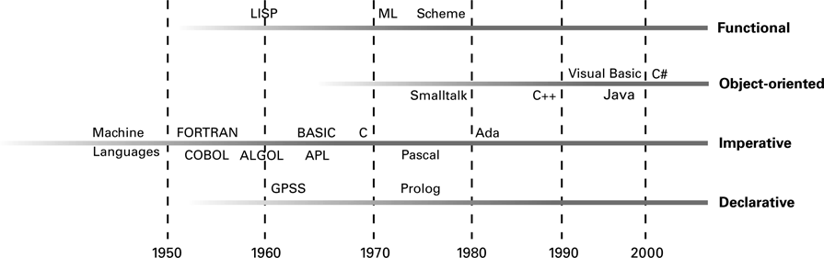
Figure 6.2 The evolution of programming paradigms
0-<number>

Slide 9
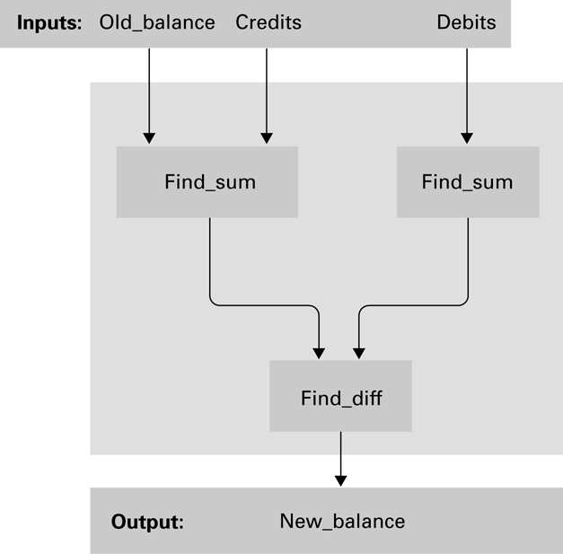
Figure 6.3 A function for checkbook balancing constructed from simpler functions
0-<number>

Slide 10
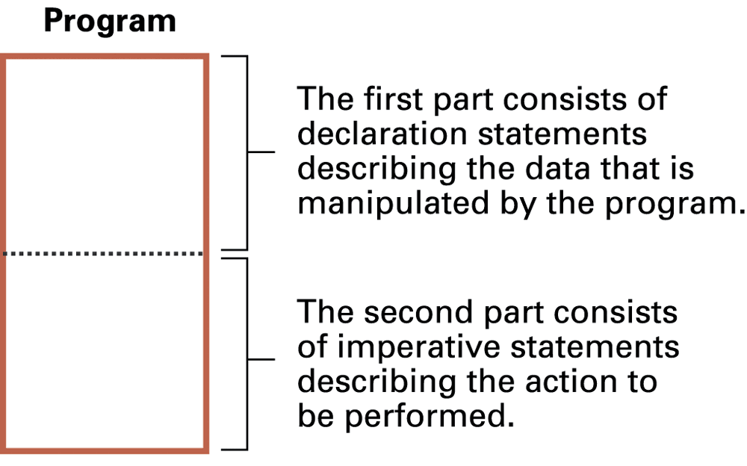
Figure 6.4 The composition of a typical imperative program or program unit
0-<number>

Slide 11
Data Types
Integer: Whole numbers
Real (float): Numbers with fractions
Character: Symbols
Boolean: True/false
0-<number>

Slide 12
Variable Declarations
float Length, Width;
int Price, Total, Tax;
char Symbol;
0-<number>

Slide 13
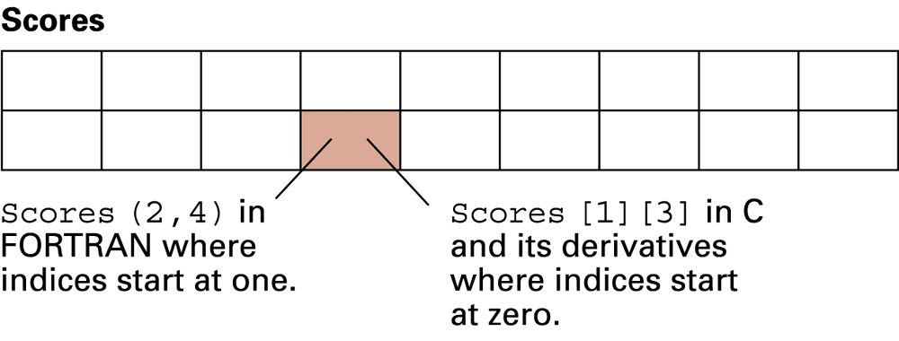
Figure 6.5 A two-dimensional array with two rows and nine columns
0-<number>

Slide 14
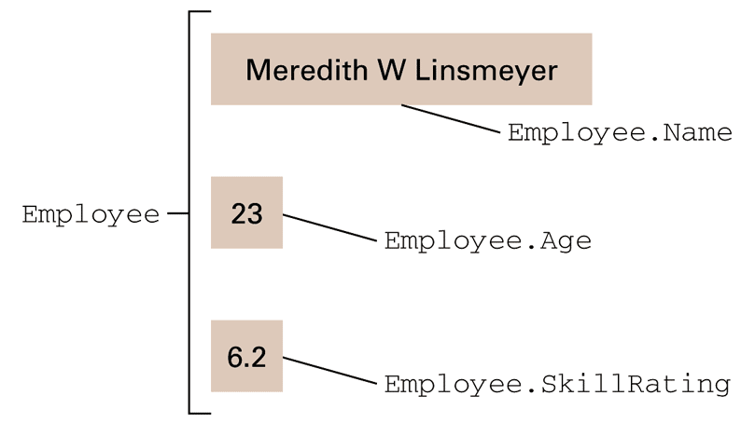
Figure 6.6 The conceptual structure of the aggregate type Employee
0-<number>

Slide 15
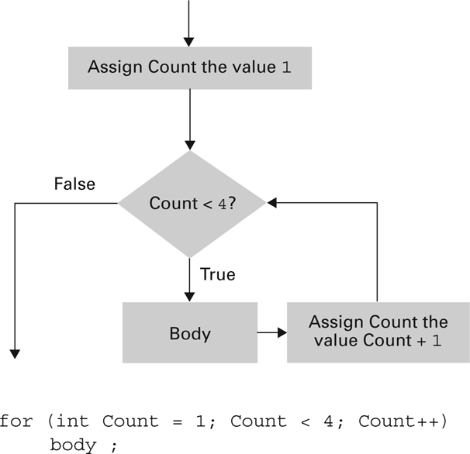
Figure 6.7 The for loop structure and its representation in C++, C#, and Java
0-<number>

Slide 16
Procedural Units
Local versus Global Variables
Formal versus Actual Parameters
Passing parameters by value versus reference
Procedures versus Functions
0-<number>

Slide 17
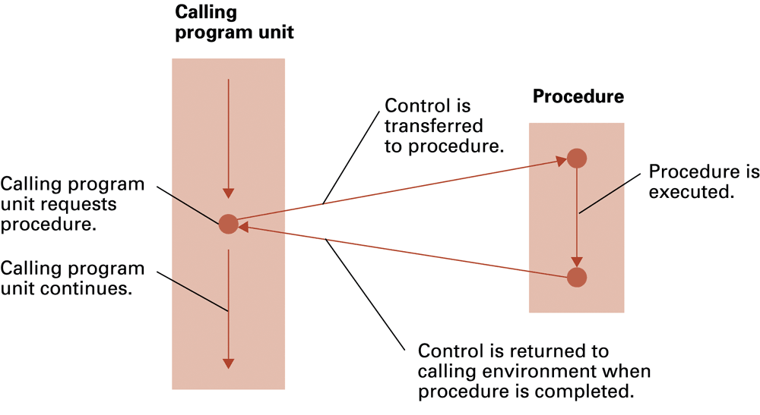
Figure 6.8 The flow of control involving a procedure
0-<number>

Slide 18
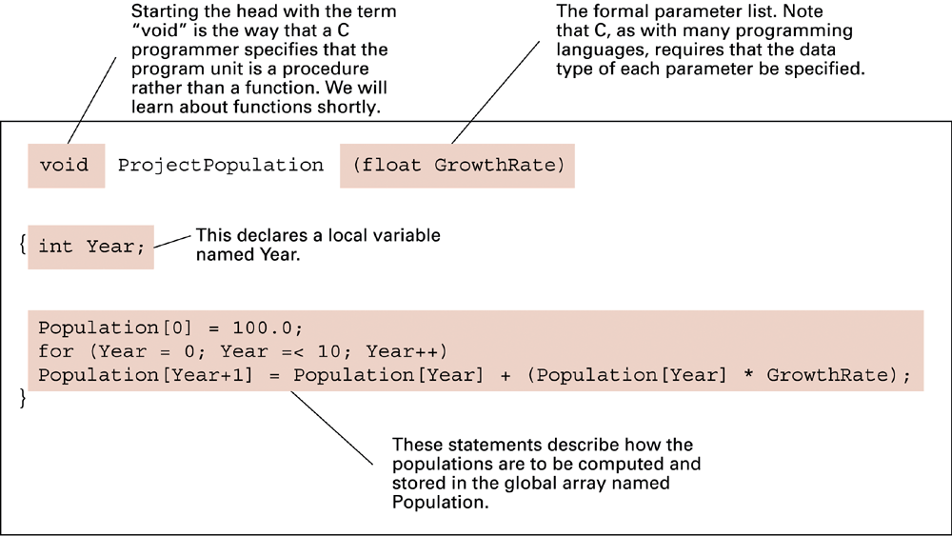
Figure 6.9 The procedure ProjectPopulation written in the programming language C
0-<number>

Slide 19
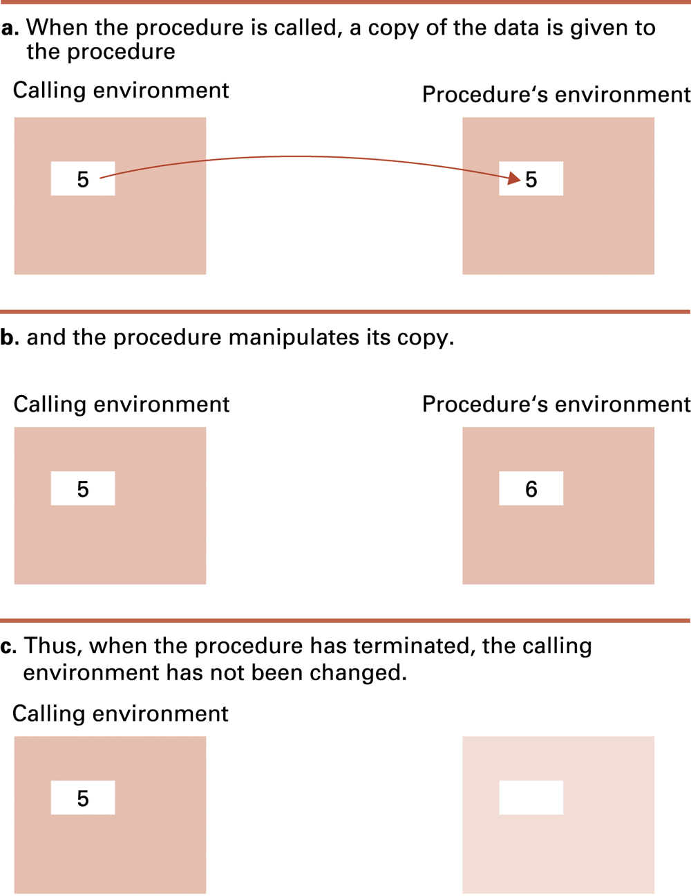
Figure 6.10 Executing the procedure Demo and passing parameters by value

Slide 20
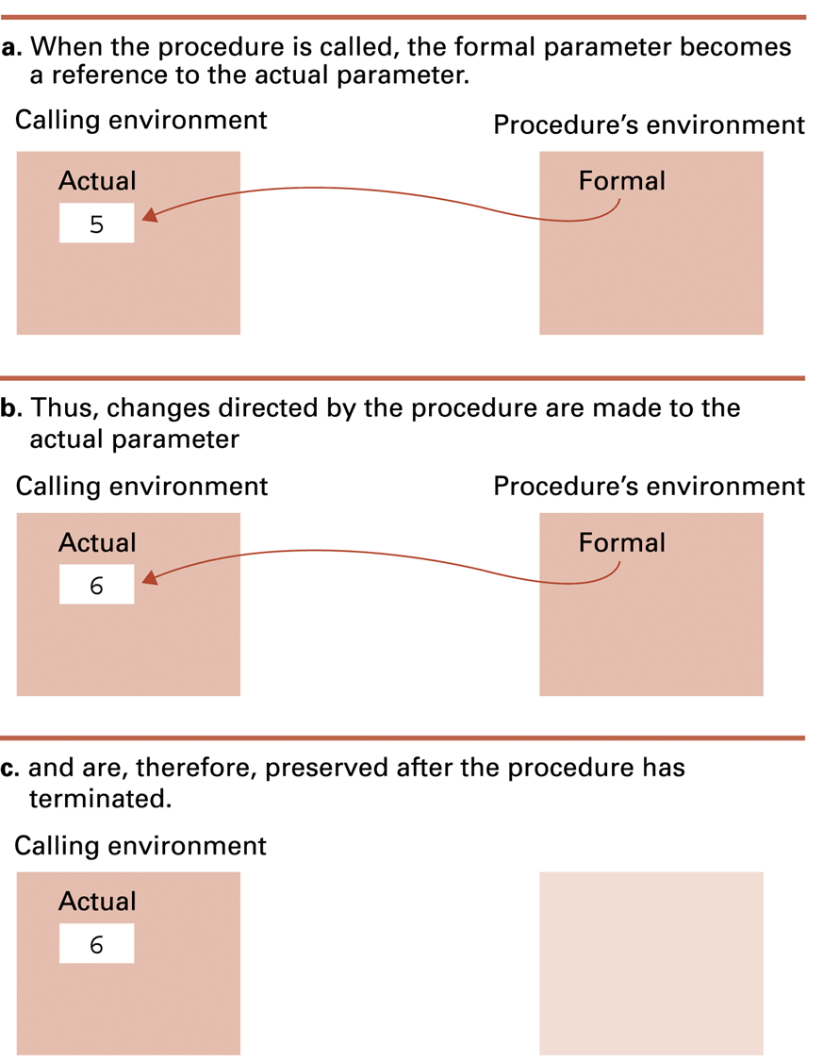
Figure 6.11 Executing the procedure Demo and passing parameters by reference

Slide 21
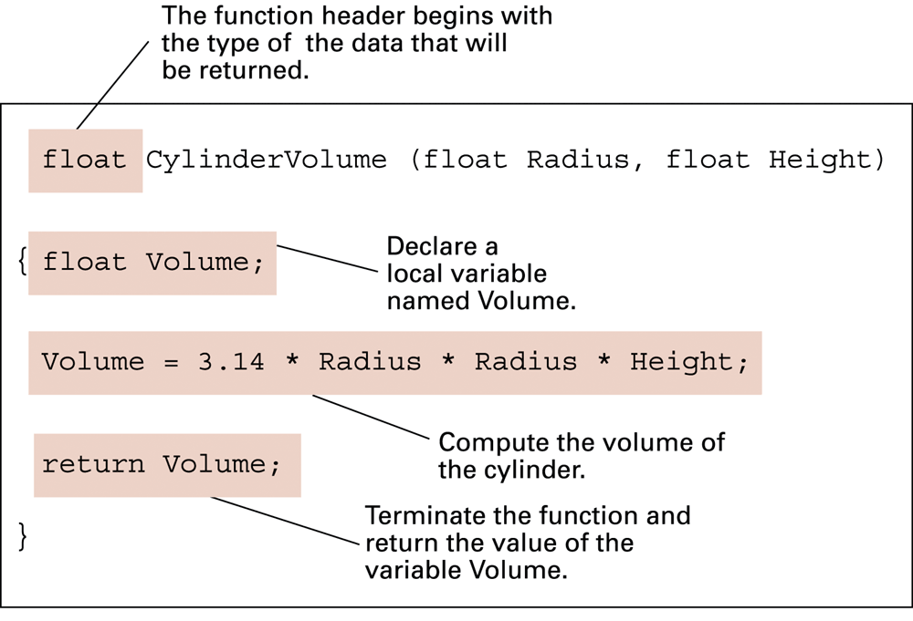
Figure 6.12 The function CylinderVolume written in the programming language C
0-<number>

Slide 22

Figure 6.13 The translation process
0-<number>

Slide 23
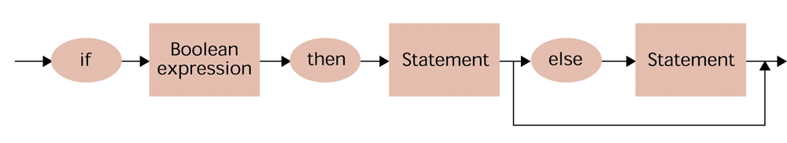
Figure 6.14 A syntax diagram of our if-then-else pseudocode statement
0-<number>

Slide 24
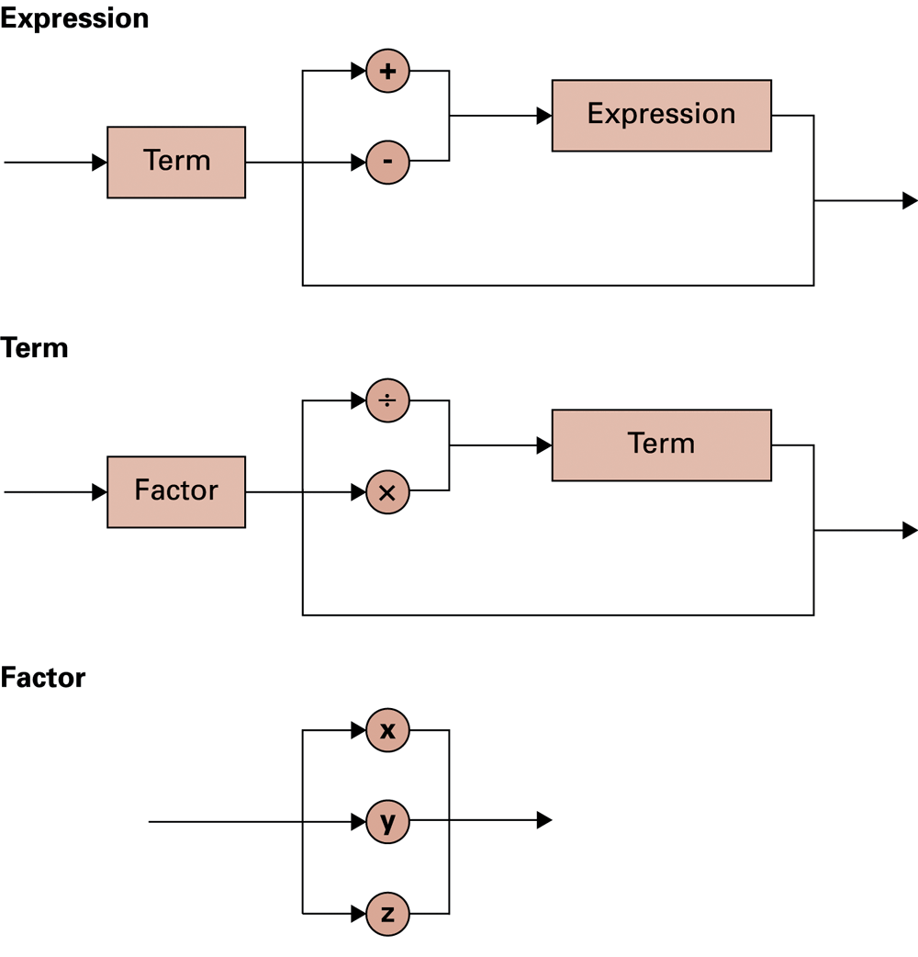
Figure 6.15 Syntax diagrams describing the structure of a simple algebraic expression
0-<number>

Slide 25
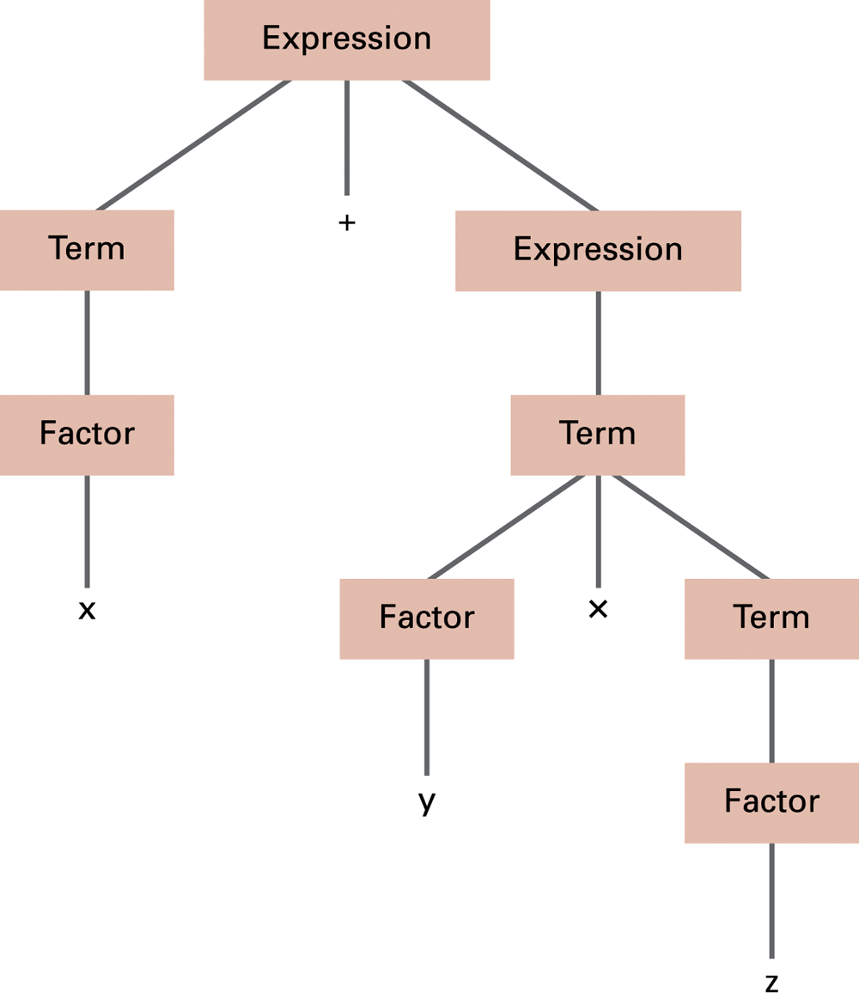
Figure 6.16 The parse tree for the string x + y x z based on the syntax diagrams in Figure 6.17
0-<number>

Slide 26
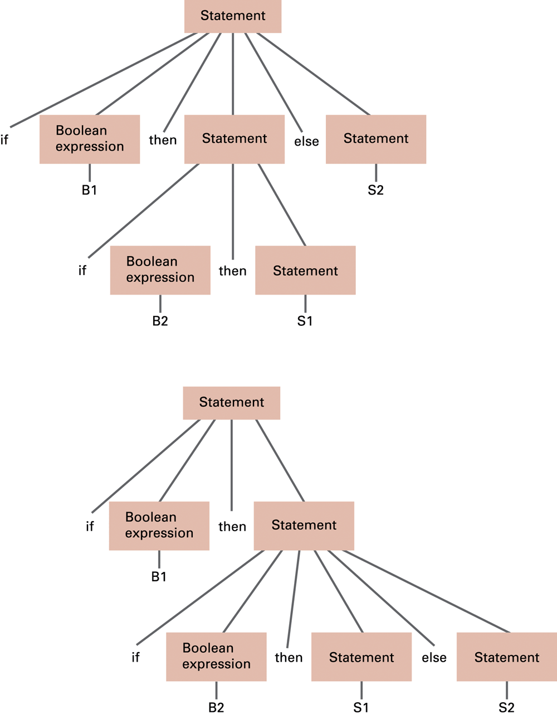
Figure 6.17
Two distinct parse trees for the statement if B1 then if B2 then S1 else S2

Slide 27
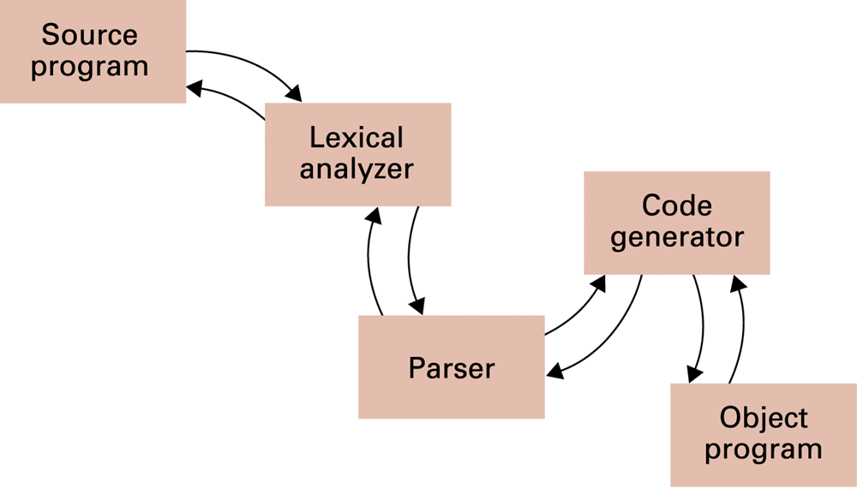
Figure 6.18 An object-oriented approach to the translation process
0-<number>

Slide 28
Objects and Classes
Object: Active program unit containing both data and procedures
Class: A template from which objects are constructed
An object is called an instance of the class.
0-<number>

Slide 29
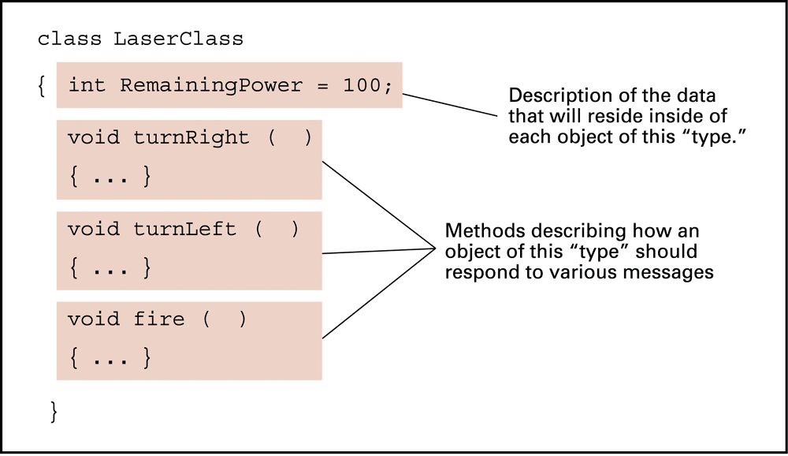
Figure 6.19 The structure of a class describing a laser weapon in a computer game
0-<number>

Slide 30
Components of an Object
Instance Variable: Variable within an object
  Holds information within the object
Method: Procedure within an object
  Describes the actions that the object can perform
Constructor: Special method used to initialize a new object when it is first constructed
0-<number>

Slide 31
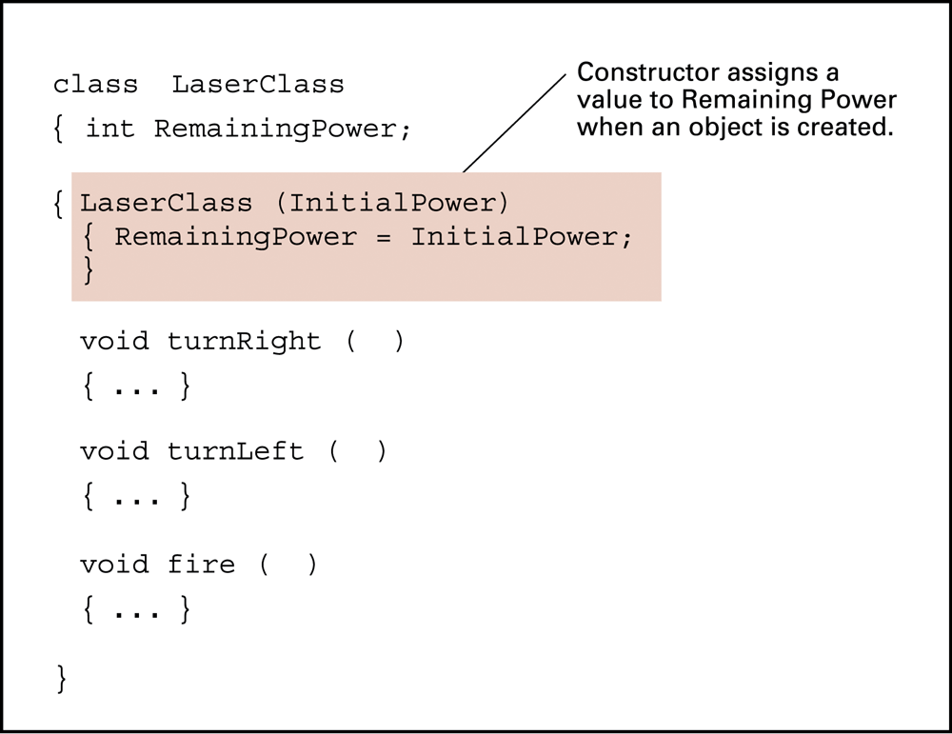
Figure 6.21 A class with a constructor
0-<number>

Slide 32
Object Integrity
Encapsulation: A way of restricting access to the internal components of an object
  Private
  Public
0-<number>

Slide 33
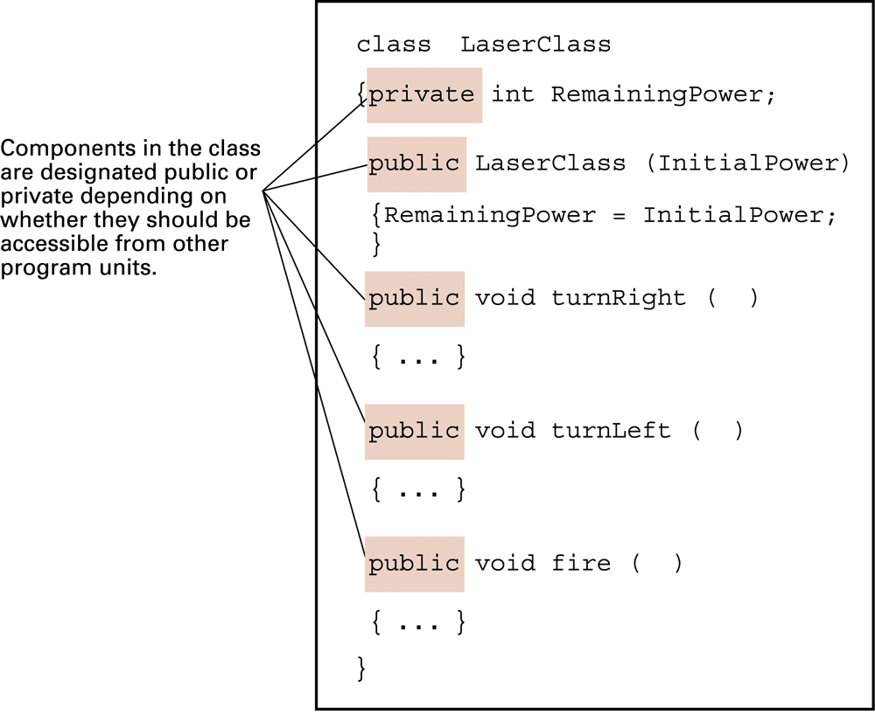
Figure 6.22 Our LaserClass definition using encapsulation as it would appear in a Java or C# program
0-<number>

Slide 34
Additional Object-oriented Concepts
Inheritance: Allows new classes to be defined in terms of previously defined classes
Polymorphism: Allows method calls to be interpreted by the object that receives the call
0-<number>

Slide 35
Programming Concurrent Activities
Parallel (or concurrent) processing: simultaneous execution of multiple processes
  True concurrent processing requires multiple CPUs
  Can be simulated using time-sharing with a single CPU
0-<number>

Slide 36
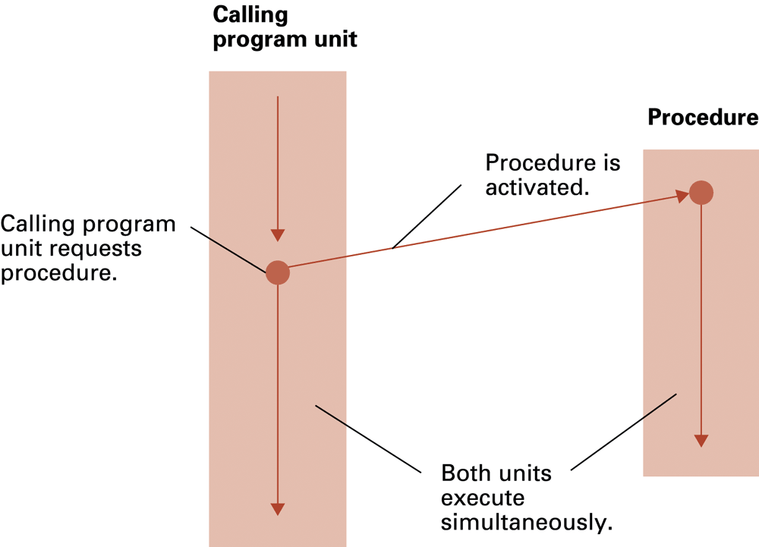
Figure 6.23 Spawning threads
0-<number>

Slide 37
Controlling Access to Data
Mutual Exclusion: A method for ensuring that data can be accessed by only one process at a time
Monitor: A data item augmented with the ability to control access to itself
0-<number>

Slide 38
Declarative Programming
Resolution: Combining two or more statements to produce a new statement (that is a logical consequence of the originals).
  Example: (P OR Q) AND (R OR ¬Q)
  resolves to (P OR R)
  Resolvent: A new statement deduced by resolution
  Clause form: A statement whose elementary components are connected by the Boolean operation OR
Unification: Assigning a value to a variable so that two statements become “compatible.”
0-<number>

Slide 39
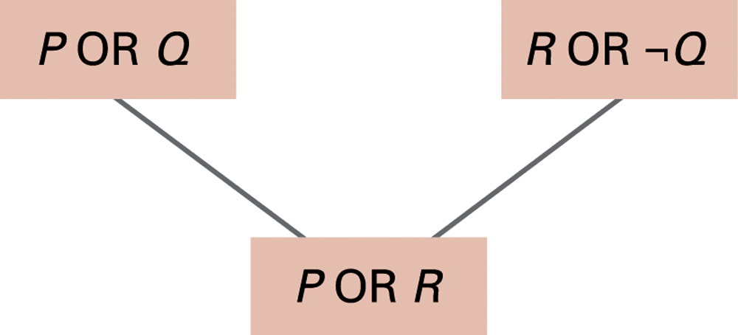
Figure 6.24 Resolving the statements (P OR Q) and (R OR ¬Q) to produce (P OR R)
0-<number>

Slide 40
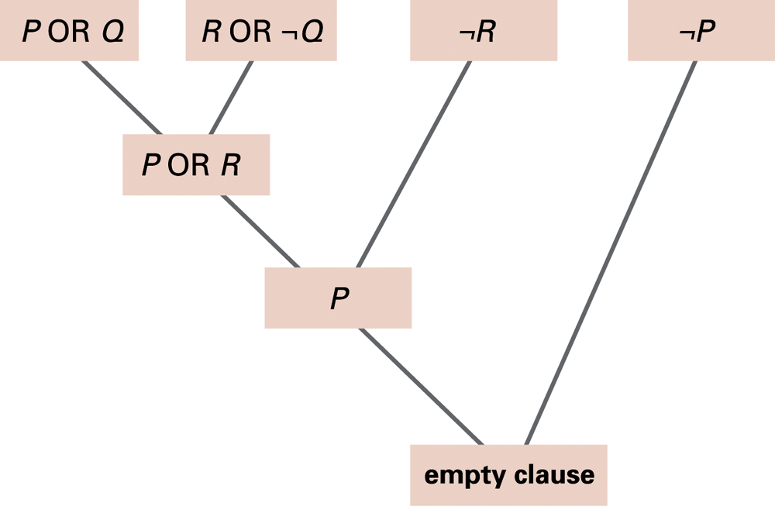
Figure 6.25 Resolving the statements (P OR Q), (R OR ¬Q), ¬R, and ¬P
0-<number>

Slide 41
Prolog
Fact: A Prolog statement establishing a fact
  Consists of a single predicate
  Form: predicateName(arguments).
    Example: parent(bill, mary).
Rule: A Prolog statement establishing a general rule
  Form: conclusion :- premise.
    :- means “if”
  Example: wise(X) :- old(X).
  Example: faster(X,Z) :- faster(X,Y), faster(Y,Z).
0-<number>

